Slide 1



Seminar
Formal Verification of RL-based Approaches
Amin René Filip
deine.email@tum.de rene.filip@tum.de
SS 2018

Slide 2
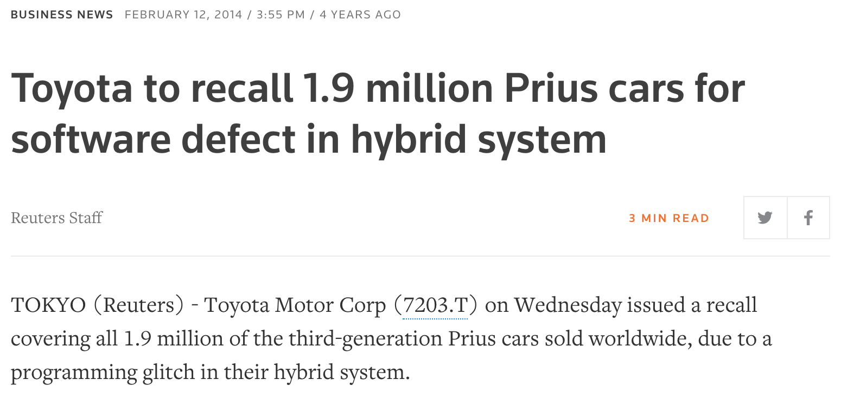
Testing does not suffice

Slide 3
Testing does not suffice
“Program testing can be a very effective way to show the presence of bugs, but is hopelessly inadequate for showing their absence.“
Edsger W. Dijkstra

Slide 4
Topics
Why Formal Verification?
Introduction to Formal Verification
Verifiable Properties
Verification of an MDP
Formal Verification Methods
Verification of a Policy
Summary and Challenges
Runtime Verification

Slide 5
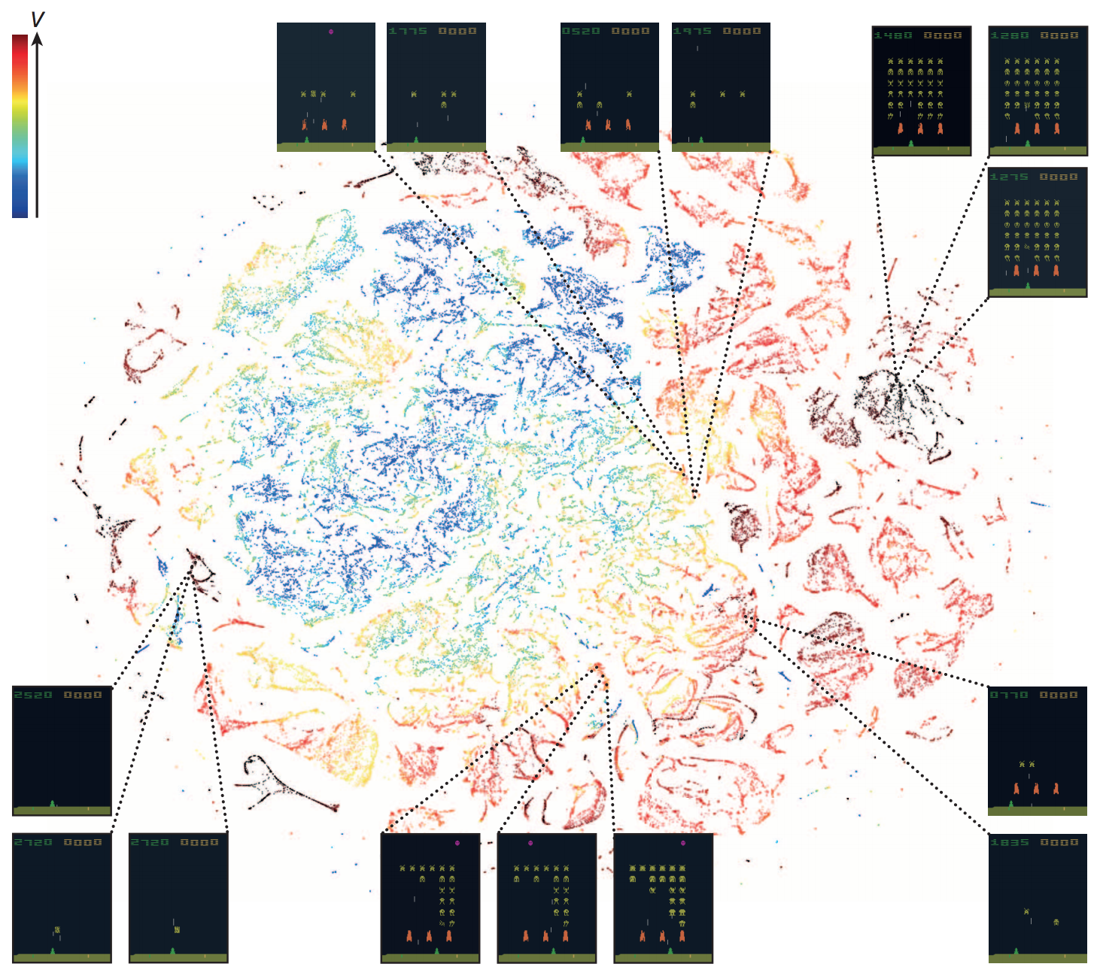
Models become too complex!

Slide 6
Adversarial Examples

Slide 7
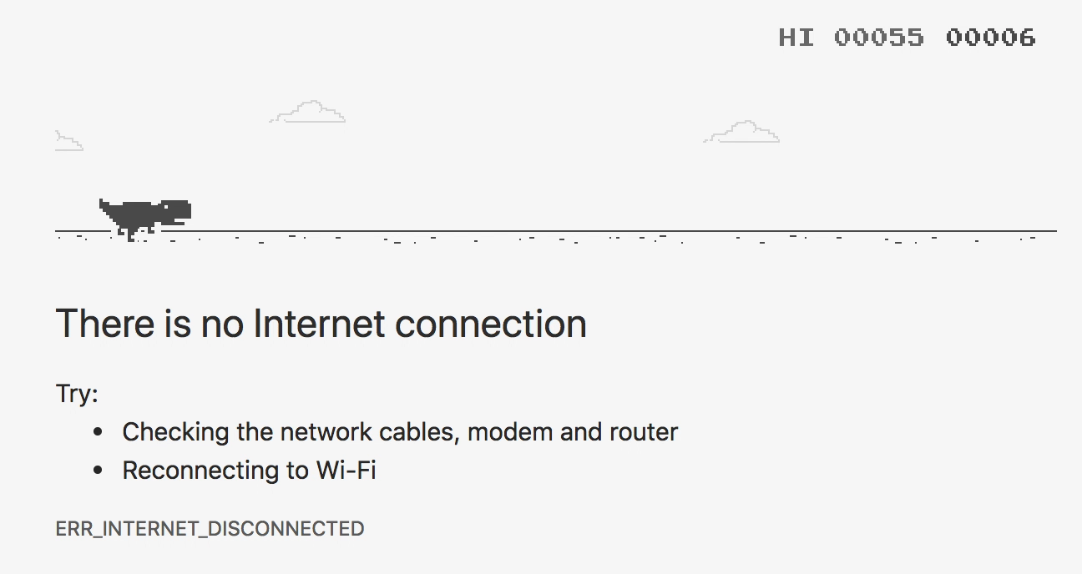
Safe and Fast Exploration
Exploration too dangerous and inefficent
Inject domain knowledge via specifications

Slide 8
Optimization vs Safety
Clever RL Algorithm
Problem
Optimized Policy
+
Theorem Solver
Specification
Safe Policy
Optimized and Safe Policy?

Slide 9
Model Verification
RL
MDP
Optimized Policy
Does my MDP reflect the reality?
Will at least 95% of my runs end up in a good state?

Slide 10
Policy Verification
Environment,
partial MDP
RL
Optimized Policy
Is my policy stable?
Can I ensure certain actions won’t happen in a specific state?
Can it deal with perturbations?

Slide 11
Code Verification
RL Implementation
1. if (p < 0.1) {
2. // do something
3. } else {
4. // do something else
5. }
Did I implement the code correctly?
RL
MDP
Optimized Policy

Slide 12
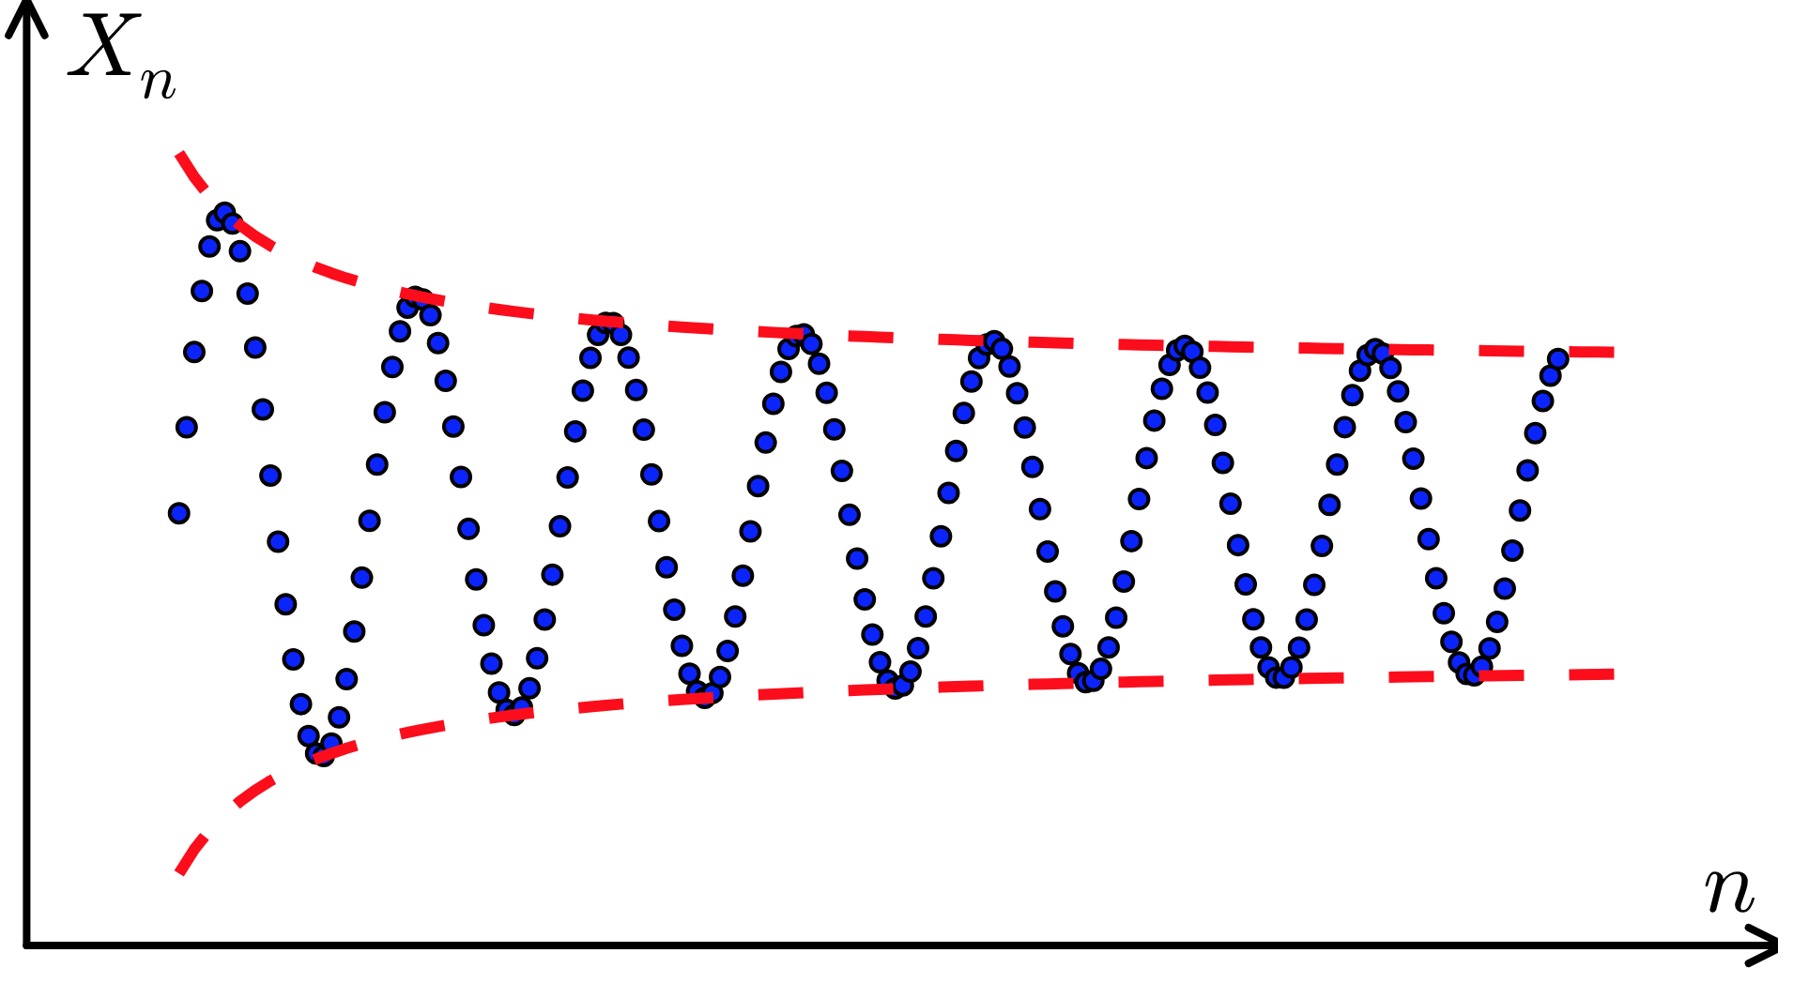
Algorithm Verification
Will my algorithm converge to a policy?
RL
MDP
Optimized Policy

Slide 13
Runtime Verification
RL
Environment
Optimized Policy
Monitor
Specifications
Model
Guarantee only safe actions!
Can I accelerate the training?

Slide 15
Approaches
Informal methods:
Avoid bugs:
Appropriate programming languages
Software engineering methods
Detect bugs:
Simulation, testing
Formal methods:
Prove absence of bugs:
Deductive methods
Program analysis
Detect bugs and prove their absence:
Model checking

Slide 16
Comparison
Testing/Simulation | Program analysis | Deductive methods | Model checking
Subset of executions | Superset of possible executions | All possible executions Eg. (all humans are mortal) (Sokrates is a human) → (Sokrates is mortal) | All possible executions
+ cost-efficient + can find obvious bugs | + can find absence of obvious bugs (E.g. division by 0) + efficient | +complete | + works automatically + complete +can be used for concurrent, reactive & distributed systems
- incomplete | - incomplete - can yield false positive | - can yield false positive - difficult for concurrent systems - Limited by human prover | -computationally costly

Slide 17
Overview of Model checking
Model checking are methods that:
verify whether a given system satisfies a given specification
work automatically
prove correctness of the system w.r.t. to the specification
or exhibit a counterexample, i.e. an execution violating the specification

Slide 18
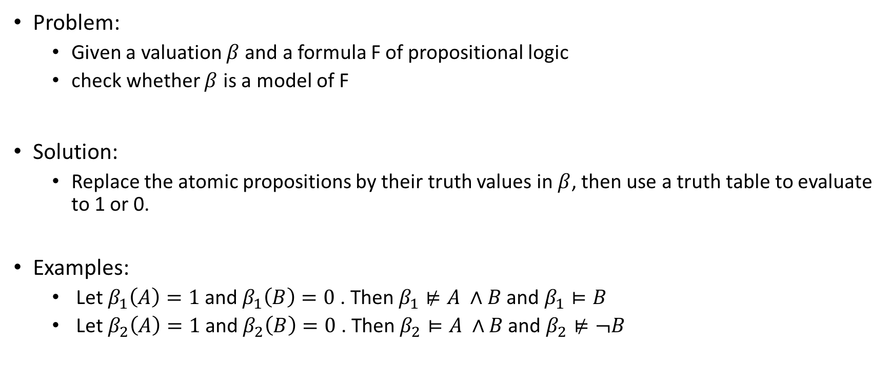
Model checking problem in Propositional logic
Problem:
Given a valuation $β$ and a formula F of propositional logic
check whether $β$ is a model of F
Solution:
Replace the atomic propositions by their truth values in $β$, then use a truth table to evaluate to 1 or 0.
Examples:
Let $β_{1}\left(A\right)=1$and $β_{1}\left(B\right)=0$. Then $β_{1}⊭A ∧B$ and $β_{1}⊨B$
Let $β_{2}\left(A\right)=1$and $β_{2}\left(B\right)=0$. Then $β_{2}⊨A ∧B$ and $β_{2}⊭¬B$

Slide 19
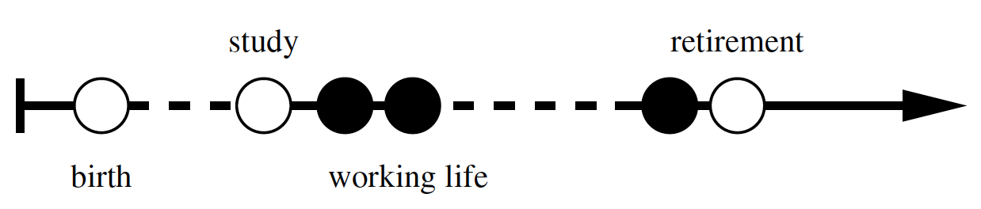
Temporal logic
Truth values of atomic proposition may change with time
Example: Truth values of A in the course of Anna’s life
Possible statements :
Anna will eventually be an architect (at some point in the future)
Anna is an architect until she retires.
Extension of propositional log with temporal connectives (eventually, until)

Slide 20
Approaches for temporal logics
Linear-time temporal logics (LTL)
Formulae with temporal operators
Evaluated w.r.t (infinite) sequences of valuations
Model-checking problem for LTL:
Given an LTL formula and a sequence of valuations, check whether the sequence is a model of the formula
Computation-tree logic (CTL, CTL*)
Considers (infinite) trees of valuations
Interpretation : non-determinism, multiple possible developments

Slide 21
CTL: Example
Computational tree:
accelerate
accelerate
brake
CTL formula : AGEF brake
Interpretation: “ From any state you can always reach the brake state”
.
.
.
.
.
.
.
.
.
.
.
.
.
.
.
.

Slide 22
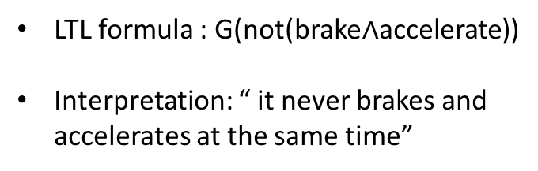
LTL Example
LTL formula : G(not(brake$∧$accelerate))
Interpretation: “ it never brakes and accelerates at the same time”
accelerate
brake
LTL path:
accelerate
brake
brake
accelerate
…..
accelerate
brake
accelerate
accelerate
…..
.
.
.
.
.
.
.
.
.
.
.
.
.
.
.
.

Slide 23
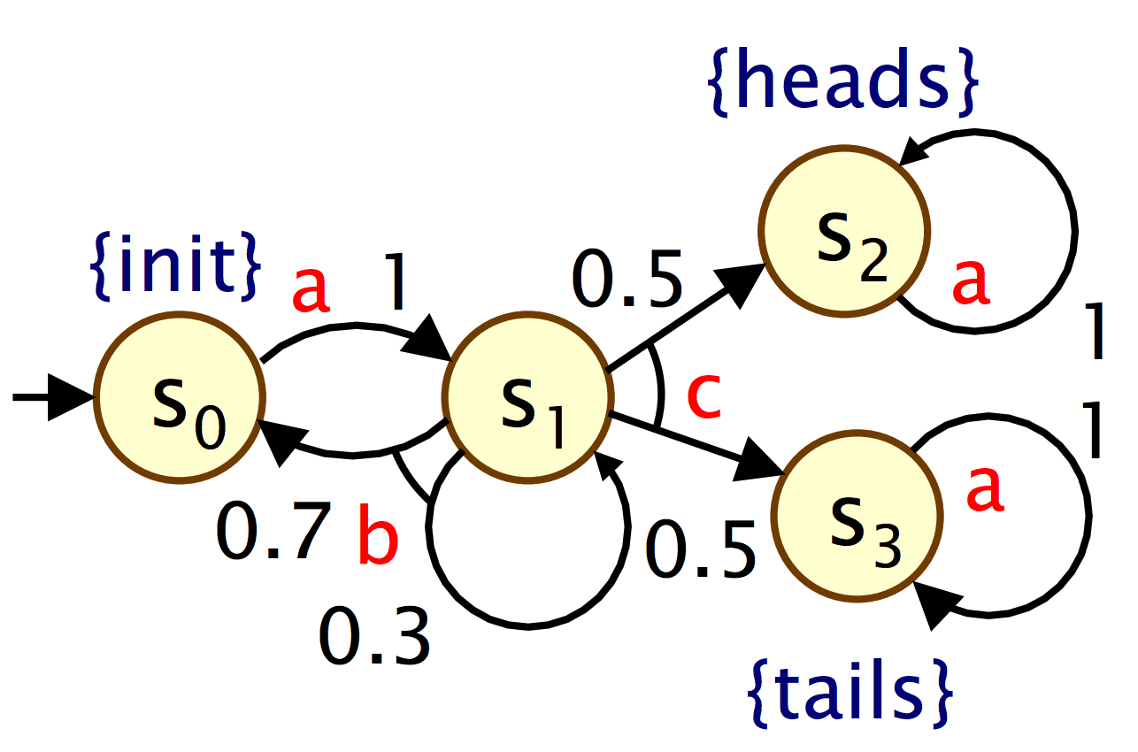
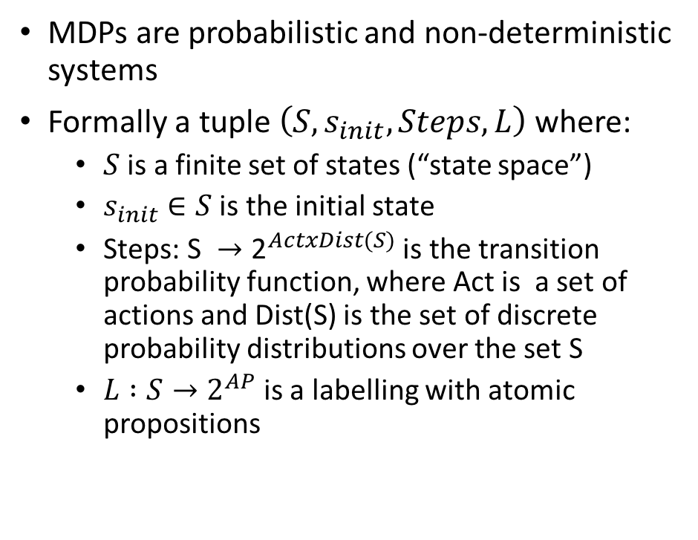
Probabilistic Model checking for MDPs
MDPs are probabilistic and non-deterministic systems
Formally a tuple $\left(S, s_{init}, Steps, L\right)$where:
$S$ is a finite set of states (“state space”)
$s_{init}∈S$ is the initial state
$\text{Steps}\text{: }\text{S} →{\text{2}}^{ActxDist(S)}$ is the transition probability function, where Act is a set of actions and Dist(S) is the set of discrete probability distributions over the set S
$L :S→2^{AP}$is a labelling with atomic propositions

Slide 24
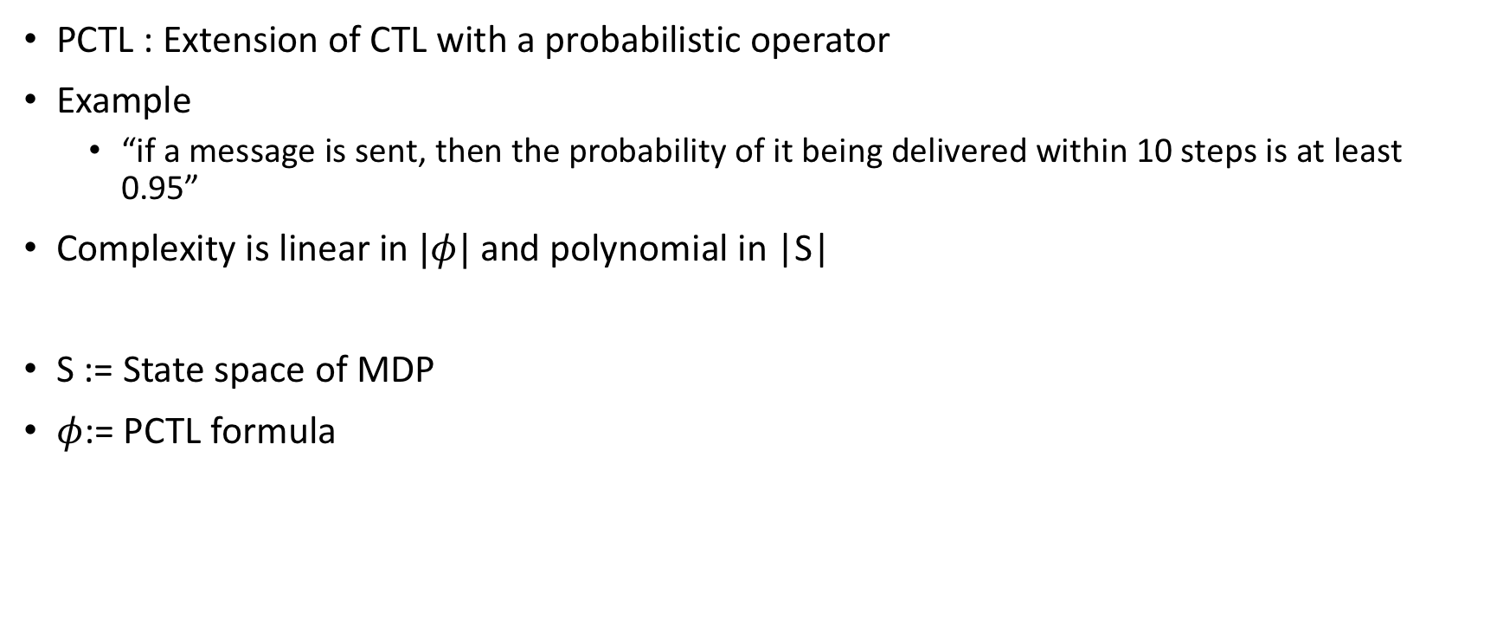
Probabilistic Model checking for MPDs in PCTL
PCTL : Extension of CTL with a probabilistic operator
Example
“if a message is sent, then the probability of it being delivered within 10 steps is at least 0.95”
Complexity is linear in $|φ|$ and polynomial in |S|
S := State space of MDP
$φ$:= PCTL formula

Slide 25
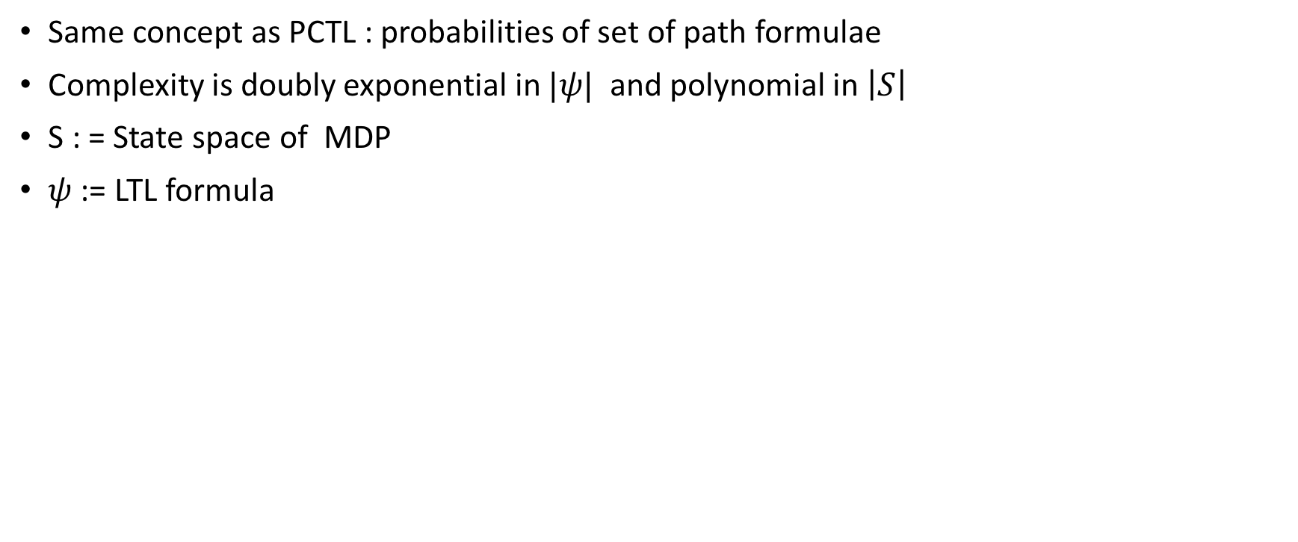
Probabilistic Model checking for MPDs in pLTL
Same concept as PCTL : probabilities of set of path formulae
Complexity is doubly exponential in $|ψ|$ and polynomial in $\left|S\right|$
S : = State space of MDP
$ψ$ := LTL formula

Slide 26
Probabilistic Model Checking Tool : PRISM
PRISM: Probabilistic symbolic model checker
Developed at Birmingham/Oxford University, since 1999
Free and open source
Model checking of :
PCTL, pLTL …
Symbolic data structures
State explosion problem: Compact storage by exploiting regularity (using Binary decision diagrams)
PRISM website: http://www.prismmodelchecker.org/

Slide 28
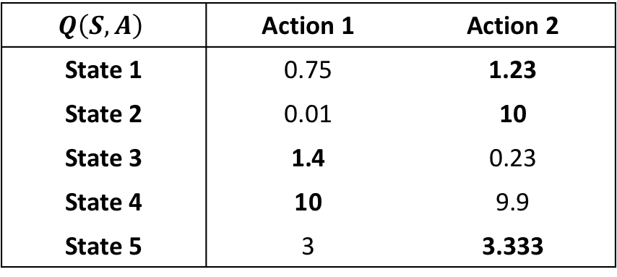
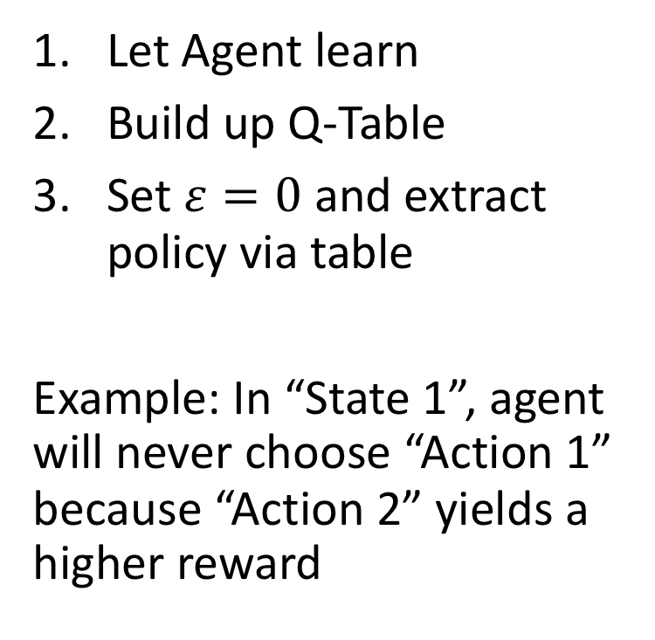
State to Action Verification in Q-Learning
$$Q\left(S, A\right)$$ | Action 1 | Action 2
State 1 | 0.75 | 1.23
State 2 | 0.01 | 10
State 3 | 1.4 | 0.23
State 4 | 10 | 9.9
State 5 | 3 | 3.333
Let Agent learn
Build up Q-Table
Set $ε=0$ and extract policy via table
Example: In “State 1”, agent will never choose “Action 1” because “Action 2” yields a higher reward
large / continuous

Slide 29
State to Action Verification in Q-Learning
$$Q\left(S, A\right)$$ | Action 1 | Action 2
State 1 | 0.75 | 1.23
State 2 | 0.01 | 10
State 3 | 1.4 | 0.23
State 4 | 10 | 9.9
State 5 | 3 | 3.333
Let Agent learn
Build up Q-Table
Set $ε=0$ and extract policy via table
Example: In “State 1”, agent will never choose “Action 1” because “Action 2” yields a higher reward
large / continuous

Slide 30
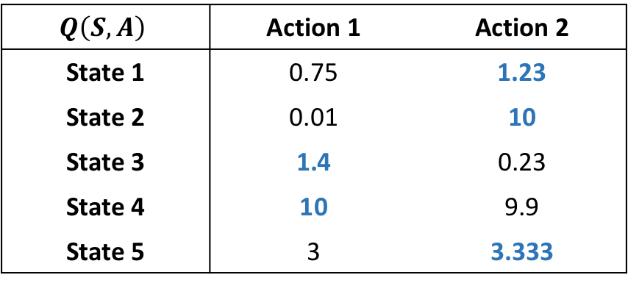
Verification of a Policy
$$Q\left(S, A\right)$$ | Action 1 | Action 2
State 1 | 0.75 | 1.23
State 2 | 0.01 | 10
State 3 | 1.4 | 0.23
State 4 | 10 | 9.9
State 5 | 3 | 3.333
trivial to verify
typically large
non-linear

Slide 31
Verification of a Policy
“stop the car”

Slide 32
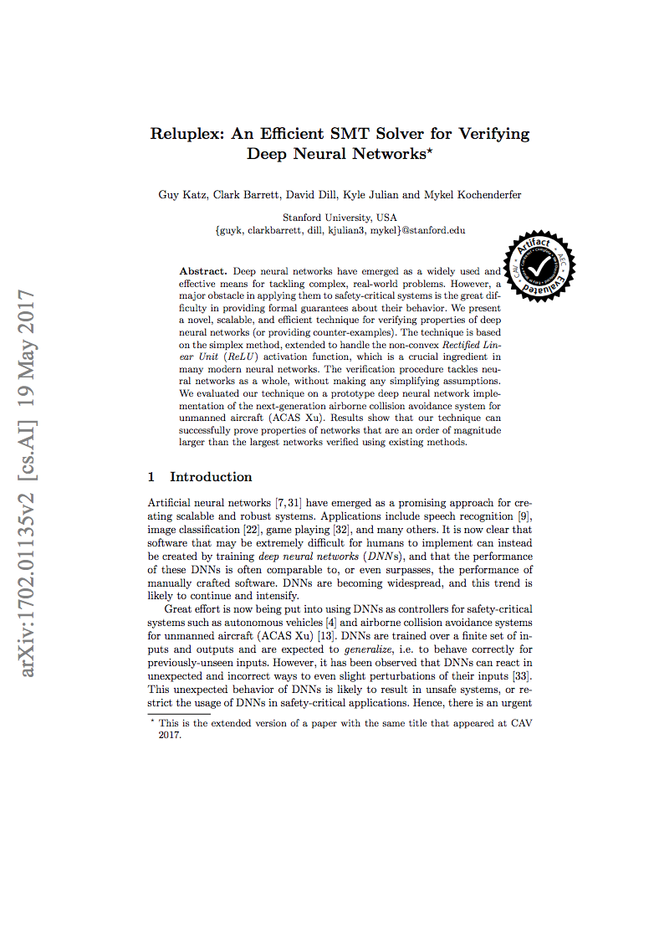
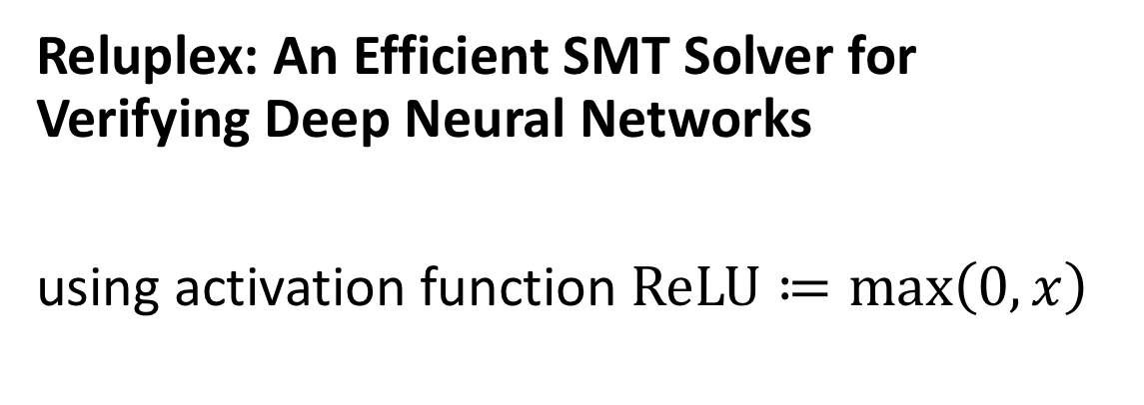
Reluplex: An Efficient SMT Solver for Verifying Deep Neural Networks
using activation function $ReLU≔\max\left(0,x\right)$

Slide 33
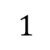
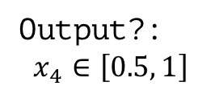
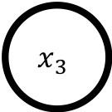
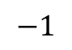
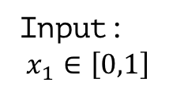
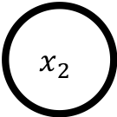
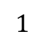
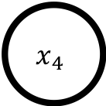
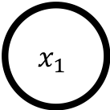
Simple Neural Network
$$x_{2}$$
$$1$$
$$1$$
Input:
$$x_{1}∈\left[0,1\right]$$
$$x_{1}$$
$$x_{4}$$
Output?:
$$x_{4}∈\left[0.5, 1\right]$$
$$−1$$
$$x_{3}$$
$$1$$
not easy to solve…

Slide 35
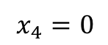
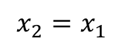
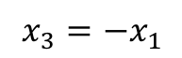
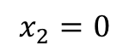
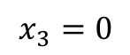
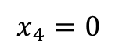
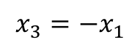
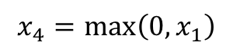
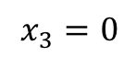
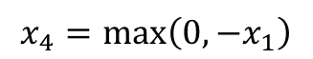
Case Splitting to make it linear
$$x_{2}=0$$
$$x_{2}=x_{1}$$
$$x_{3}=0$$
$$x_{3}=−x_{1}$$
$$x_{3}=0$$
$$x_{3}=−x_{1}$$
$$x_{4}=0$$
$$x_{4}=\text{max}\left(0, −x_{1}\right)$$
$$x_{4}=\max\left(0, x_{1}\right)$$
$$x_{4}=0$$

Slide 36
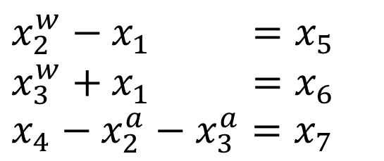
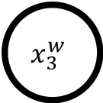
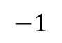
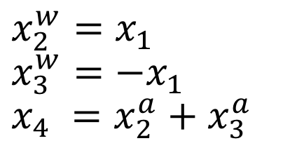
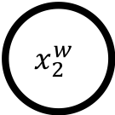
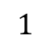
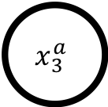

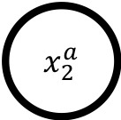
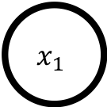
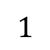
1. Split and Rewrite Equations
$$x_{2}^{w}$$
ReLU
$x_{2}^{a}$
$$1$$
$$1$$
$$x_{1}$$
$$x_{4}$$
$$−1$$
$$x_{3}^{w}$$
ReLU
$$x_{3}^{a}$$
$$1$$
$$x_{2}^{w}=x_{1}$$
$$x_{3}^{w}=−x_{1}$$
$$x_{4} =x_{2}^{a}+x_{3}^{a}$$
$$x_{2}^{w}−x_{1} =x_{5}$$
$$x_{3}^{w}+x_{1} =x_{6}$$
$$x_{4}−x_{2}^{a}−x_{3}^{a}=x_{7}$$

Slide 37
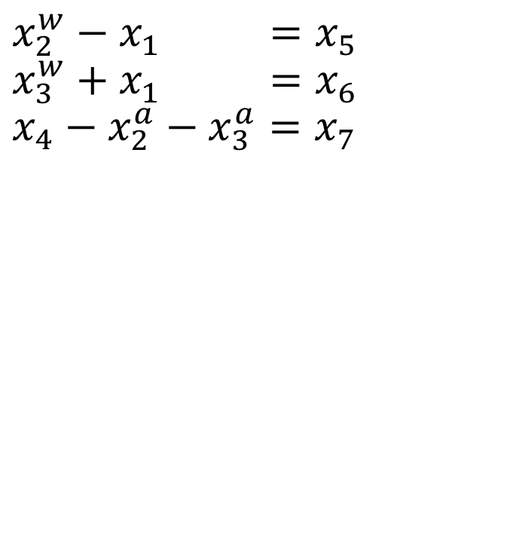
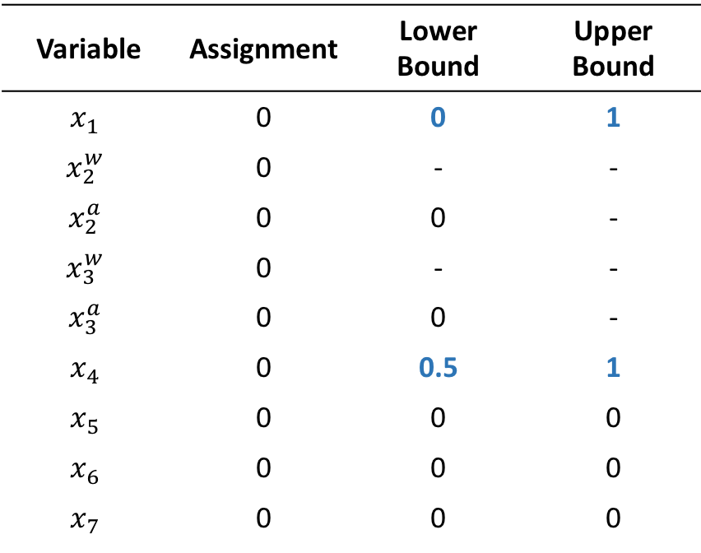
2. Find assignment for new set of equations
Variable | Assignment | Lower Bound | Upper Bound
$$x_{1}$$ | 0 | 0 | 1
$$x_{2}^{w}$$ | 0 | - | -
$$x_{2}^{a}$$ | 0 | 0 | -
$$x_{3}^{w}$$ | 0 | - | -
$$x_{3}^{a}$$ | 0 | 0 | -
$$x_{4}$$ | 0 | 0.5 | 1
$$x_{5}$$ | 0 | 0 | 0
$$x_{6}$$ | 0 | 0 | 0
$$x_{7}$$ | 0 | 0 | 0
$$x_{2}^{w}−x_{1} =x_{5}$$
$$x_{3}^{w}+x_{1} =x_{6}$$
$$x_{4}−x_{2}^{a}−x_{3}^{a}=x_{7}$$

Slide 38
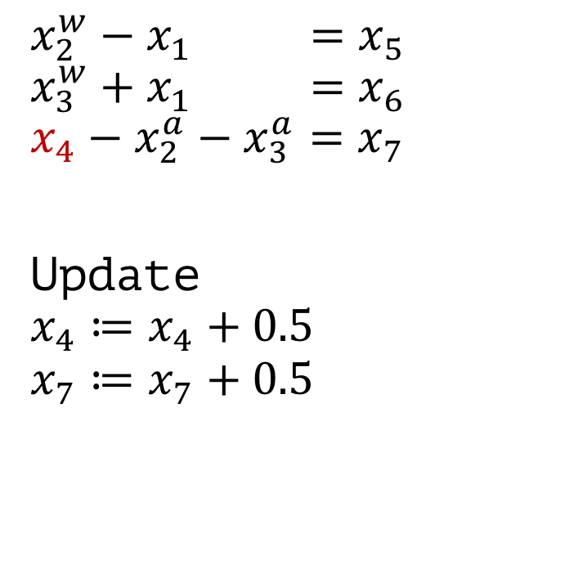
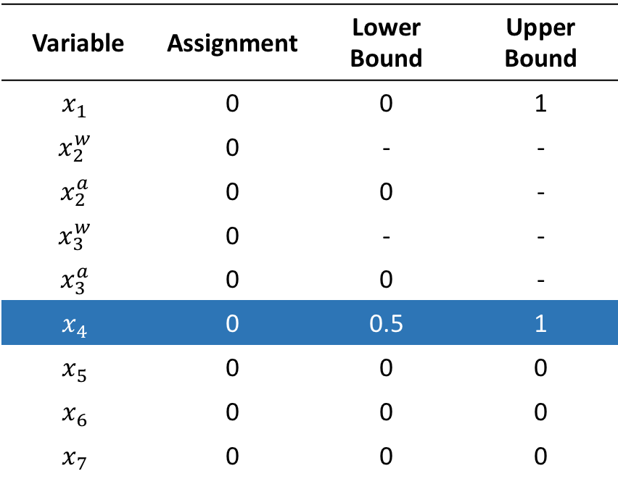
2. Find assignment for new set of equations
Variable | Assignment | Lower Bound | Upper Bound
$$x_{1}$$ | 0 | 0 | 1
$$x_{2}^{w}$$ | 0 | - | -
$$x_{2}^{a}$$ | 0 | 0 | -
$$x_{3}^{w}$$ | 0 | - | -
$$x_{3}^{a}$$ | 0 | 0 | -
$$x_{4}$$ | 0 | 0.5 | 1
$$x_{5}$$ | 0 | 0 | 0
$$x_{6}$$ | 0 | 0 | 0
$$x_{7}$$ | 0 | 0 | 0
$$x_{2}^{w}−x_{1} =x_{5}$$
$$x_{3}^{w}+x_{1} =x_{6}$$
$$x_{4}−x_{2}^{a}−x_{3}^{a}=x_{7}$$
Update $$x_{4}≔x_{4}+0.5$$
$$x_{7}≔x_{7}+0.5$$

Slide 39
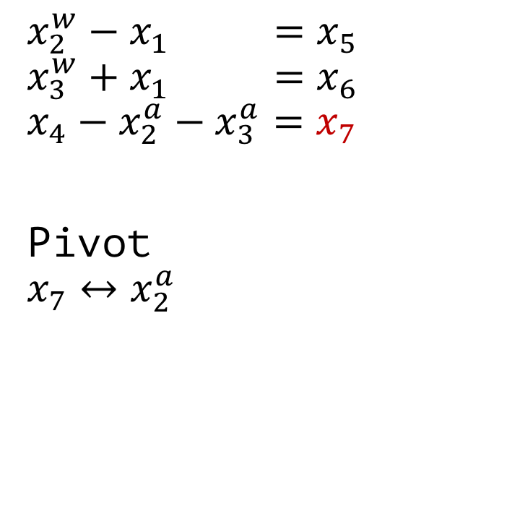

2. Find assignment for new set of equations
Variable | Assignment | Lower Bound | Upper Bound
$$x_{1}$$ | 0 | 0 | 1
$$x_{2}^{w}$$ | 0 | - | -
$$x_{2}^{a}$$ | 0 | 0 | -
$$x_{3}^{w}$$ | 0 | - | -
$$x_{3}^{a}$$ | 0 | 0 | -
$$x_{4}$$ | 0.5 | 0.5 | 1
$$x_{5}$$ | 0 | 0 | 0
$$x_{6}$$ | 0 | 0 | 0
$$x_{7}$$ | 0.5 | 0 | 0
$$x_{2}^{w}−x_{1} =x_{5}$$
$$x_{3}^{w}+x_{1} =x_{6}$$
$$x_{4}−x_{2}^{a}−x_{3}^{a}=x_{7}$$
Pivot $$x_{7}↔x_{2}^{a}$$

Slide 40

2. Find assignment for new set of equations
Variable | Assignment | Lower Bound | Upper Bound
$$x_{1}$$ | 0 | 0 | 1
$$x_{2}^{w}$$ | 0 | - | -
$$x_{2}^{a}$$ | 0 | 0 | -
$$x_{3}^{w}$$ | 0 | - | -
$$x_{3}^{a}$$ | 0 | 0 | -
$$x_{4}$$ | 0.5 | 0.5 | 1
$$x_{5}$$ | 0 | 0 | 0
$$x_{6}$$ | 0 | 0 | 0
$$x_{7}$$ | 0.5 | 0 | 0
$$x_{2}^{w}−x_{1} =x_{5}$$
$$x_{3}^{w}+x_{1} =x_{6}$$
$$x_{4}−x_{7}−{ x}_{3}^{a} =x_{2}^{a}$$
Update $$x_{7}≔x_{7}−0.5$$
$x_{2}^{a}≔x_{2}^{a}+0.5$

Slide 41


2. Find assignment for new set of equations
Variable | Assignment | Lower Bound | Upper Bound
$$x_{1}$$ | 0 | 0 | 1
$$x_{2}^{w}$$ | 0 | - | -
$$x_{2}^{a}$$ | 0.5 | 0 | -
$$x_{3}^{w}$$ | 0 | - | -
$$x_{3}^{a}$$ | 0 | 0 | -
$$x_{4}$$ | 0.5 | 0.5 | 1
$$x_{5}$$ | 0 | 0 | 0
$$x_{6}$$ | 0 | 0 | 0
$$x_{7}$$ | 0 | 0 | 0
$$x_{2}^{w}−x_{1} =x_{5}$$
$$x_{3}^{w}+x_{1} =x_{6}$$
$$x_{4}−x_{7}−{ x}_{3}^{a} =x_{2}^{a}$$
Update $$x_{2}^{w}≔x_{2}^{w}+0.5$$
$$x_{5}≔x_{5}+0.5$$

Slide 42


Final Result
Variable | Assignment | Lower Bound | Upper Bound
$$x_{1}$$ | 0.5 | 0 | 1
$$x_{2}^{w}$$ | 0.5 | - | -
$$x_{2}^{a}$$ | 0.5 | 0 | -
$$x_{3}^{w}$$ | -0.5 | - | -
$$x_{3}^{a}$$ | 0 | 0 | -
$$x_{4}$$ | 0.5 | 0.5 | 1
$$x_{5}$$ | 0 | 0 | 0
$$x_{6}$$ | 0 | 0 | 0
$$x_{7}$$ | 0 | 0 | 0
$$x_{2}^{w}−x_{1} =x_{5}$$
$$x_{3}^{w}+x_{1} =x_{6}$$
$$x_{4}−x_{7}−{ x}_{3}^{a} =x_{2}^{a}$$
This assignment solves the equation and ReLU constraints
”If $x_{1}∈\left[0,1\right]$ then $x_{4}∈\left[0.5, 1\right]$”

Slide 43

Problems
Implementation difficult (numerical errors)
How to define neighborhood of an image?
Noise?
Missing data?
What about other activation functions?
Needs to be linear
Approximation

Slide 44

“Safe Reinforcement Learning via Formal Methods”
Idea: Optimize a safe controller using RL
Explore through safe actions only
Use RL to solve optimization problem
Requirement
Controller that performs provable safe actions
(Physical) model of the reality

Slide 45

“Safe Reinforcement Learning via Formal Methods”
RL Agent
Action 1
Action …
Action $n$
Runtime
Safe Controller:
Action 1
Action 2
Action 3
Offline
Theorem Prover

Slide 47



Hybrid Program $α$
Either choose $a≔A$ or $a≔0$
Controller
Either accelerate with $A$ or break
Model differential equations describe behavior

Slide 48

Differential Dynamic Logic $dℒ$
Hybrid program
precondition
postcondition

Slide 49

Full specification $dℒ$ formula
If our car moves forward with non-negative velocity
after choosing actions, it still has a non-negative velocity

Slide 50

Controller and Model Monitor
Formula Transformations
True or False
Controller Monitor
Code
Is my action safe?
$$dℒ$$
ModelPlex
True or False
Model Monitor
Code
Does our Model comply with the reality?

Slide 51


Controller Monitor $CM$
Input: Current State $s$, Action $a$
Output: True / False
Task: Check if performing action $a$ in state $s$ is safe according to our hybrid program $α$.

Slide 52

Controller Monitor Example
performing act() will not change path or velocity
ModelPlex
$$v_{\text{post}}=\text{act}\left(v_{\text{pre}}\right)$$
v_curr
p_curr
a_curr
act()
v_post = act(v_curr); p_post = act(p_curr); a_post = act(a_curr)
return (v_post == v AND p_post == p AND a_post == A) OR (v_post == v AND p_post == p AND a_post == 0);
True
False

Slide 53


Model Monitor $MM$
Input: previous state $s$, current state $\tilde{s}$
Output: True / False
Task: Is there a transition from the previous state $s$ to the current state $\tilde{s}$ that can be explained by the model?

Slide 54
Controller Monitor Example
ModelPlex
return t_post >= 0 AND
a_post == A AND
v_post == A*t_post + v_prev AND
p_post == A*t_post^2 / 2 + v_prev*t_post + p_pre) OR
t_post >= 0 AND
a_post == 0 AND
v_post == v_pre AND
p_post == v_pos*t_post + p_pre

Slide 55
Algorithm
1. JSCGeneric(init, (S,A,R,E), choose, update, done, CM, MM) {
2. prev := curr := init;
3. a0 := NOP;
4. while (!done(curr)) {
5. if (MM(prev, curr)) {
6. u := choose({a ∈ A | CM(a, curr)});
7. } else {
8. u := choose(A);
9. }
10. prev := curr;
11. curr := E(u, prev);
12. update(prev, u, curr);
13. }
14. }
// or do something more clever (ask expert, …)

Slide 56

ModelPlex
Input: verified $dℒ$ formula $φ→\left[α^{∗}\right]ψ$
Output: (simpler) arithmetic formula
Task: Rewrite $dℒ$ formula Apply Theorem Proving until nothing can be done anymore

Slide 57


ModelPlex
Calculation Rules
Automatic Reasoning

Slide 58
Summary
There are many good reasons to formally verify a system!
Model Checking
MDP Verification via PRISM
Policy Verification of a Neural Network
Runtime Verification via Hybrid Programs

Slide 59
Does it make 100% fail prove?
Not in practice…
Specification might incomplete / wrong
Assumptions might be violated (independent and identically sampled data, …)
Alignment Problem
Numeric errors → Verification of the implementation important
Models might not reflect reality, or are too simple
Misleading Probabilities

Slide 60
Literature

